Slide 1
PROJECT :
World Economic Dataset
ROADMAP TO SUSTAINABILITY

Slide 2
BUSINESS PROBLEM:
In order to sustain GDP per capita, we need to analyze the provided World Economic Indicator Dataset and identify the crucial factors that countries should prioritize. This data analysis will help us discover meaningful insights regarding the key areas for focus.

Slide 3
SOLUTION:
We conducted data analysis on various factors from the dataset to examine their impact on a nation's GDP per capita. To address missing values, we combined the databases into a single list using a unique identifier and employed VLOOKUP. We refrained from using aggregated methods or zero values as the information is specific to individual countries and regions for a particular year, making it unsuitable for generalization across all countries. When a missing entry lacked the previous year's value, we left it blank for the analysis. Outliers in the dataset were not considered in our analysis.

Slide 4
DATA USED:
The columns from the dataset used for our consideration are as follows:
GDP/Capita | Health Exp % GDP | Lending Interest
Energy Usage/Capita | CO2 Emissions/Capita | Birth Rate
Infant Mortality Rate | Life Expectancy Total/Capita | Population 15-64
Population Urban | Tourism Inbound/Capita | Tourism Outbound/Capita
Business Tax Rate | Days to start business | Ease of Business
Hours to do tax | Internet Usage | Mobile Phone Usage

Slide 5
World Economic Indicator
The ways for a country to achieve sustainable growth

Slide 6
What are the factors on which country should focus on to sustain GDP of the nation
The analysis considered data from the past 12 years of various countries.
A positive correlation was observed between GDP per capita and Health Expenditure. Nations with higher health expenditure as a percentage of GDP tend to have higher GDP per capita.
The correlation between GDP per capita and Infant Mortality Rate is negative, indicating that countries with lower infant mortality rates tend to have higher GDP per capita.
Conversely, there is a positive correlation between GDP per capita and Life Expectancy Rate. Countries with higher life expectancy rates tend to have higher GDP per capita.
This suggests that investing in healthcare and improving life expectancy while reducing infant mortality can lead to enhanced GDP for a nation.

Slide 7
Alongside Health Expenditure, focusing on the Tourism sector can significantly enhance a country's GDP. Tourism Inbound per Capita has a strong positive correlation with a nation's GDP.
Energy Usage per Capita and CO2 Emissions per Capita also show a strong positive correlation with a country's GDP. While not environmentally favorable, these indicators can be seen as signs of a growing economy, with increased production, infrastructure development, and CO2 emissions.
Urbanization plays a vital role in boosting a nation's GDP. Countries with higher urban population percentages and more people in the 15-64 age group tend to have better GDP per capita compared to others.
The taxation rules imposed on citizens also impact a nation's GDP per capita. Lending Interest Rate, Hours to do Tax, and Business Tax Rate exhibit a negative correlation with the GDP of the nation. Lower values in these indicators are associated with better GDP per capita.

Slide 8
Countries should prioritize easing rules and regulations for new businesses, as those with better ease of doing business and shorter starting days requirements tend to have higher GDP per capita compared to others.
Digitizing country resources and the economy can contribute to improved literacy among citizens and enhance the nation's GDP per capita. Internet Usage and Mobile Phone Usage have an extremely positive correlation with a country's GDP.
Implementing a 2-child policy could be beneficial for heavily populated countries, as Birth Rate shows a strong negative correlation with the GDP per capita. Lower birth rates result in reduced burden on the country's resources and economy, leading to a better GDP. However, caution should be exercised, as highly populated countries must consider the potential adverse effects of "population ageing," which can reduce the GDP per capita of the nation.

Slide 9
Factors on which Country’s GDP/ Capita depends:
More the heath expenditure %, more the GDP/capita of the nation.
Lower the Infant mortality rate, higher the GDP/capita of the nation.
Higher the life expectancy, higher the GDP/capita of the nation.

Slide 10
Higher the Tourism Inbound/capita, higher the GDP/capita of the nation.
Higher the Energy Usage/capita, higher the GDP/capita of the nation.
Higher the CO2 Emissions/Capita, higher the GDP/Capita of the nation.
More urban population countries shows higher GDP/capita compared to others.
Higher the workforce in the 15-64 age group, higher the GDP/capita of the nation.
Lesser the Lending Interest value, lesser the GDP/capita of the nation.

Slide 11
Lesser the time to prepare to prepare & pay taxes in hours per year, higher the GDP/capita of the nation.
Lesser the Business Tax Rate, higher the GDP/capita of the nation.
Lesser the Ease of Business (considered 1 = easiest), higher the GDP/capita of the nation.
Lesser the no. of days to start business, higher the GDP/capita of the nation.
Higher the Internet usage among the nation’s population, higher the GDP/capita of the nation.
Higher the mobile phone usage among population, higher the GDP/capita of the nation.

Slide 12
Higher the GDP/capita of the nation, higher the amount spent by citizens on tourism by visiting other countries.
Lesser the Birth rate of the nation, higher the GDP/capita of the nation.

Slide 13
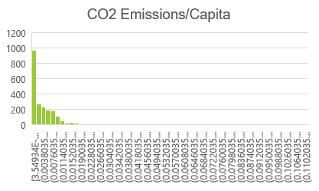
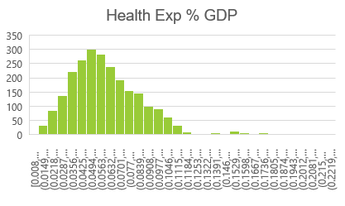
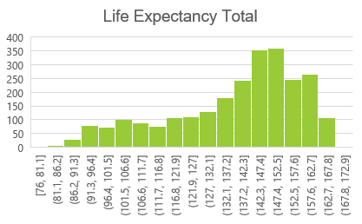
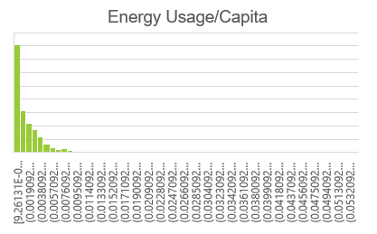
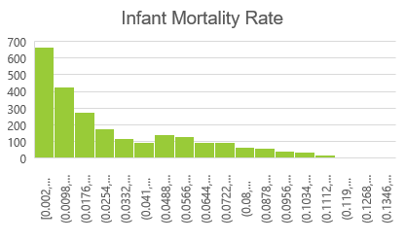
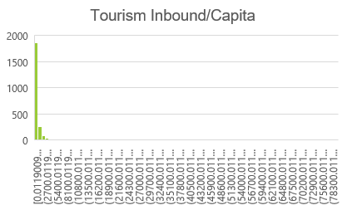
Univariate Analysis performed on the datasets to find out Outliers & nature of the dataset:

Slide 14
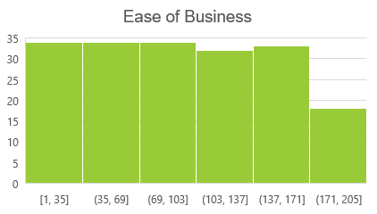
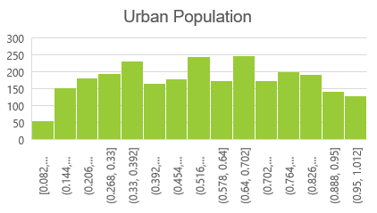
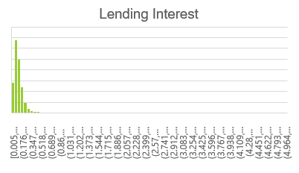
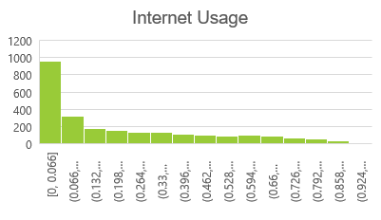
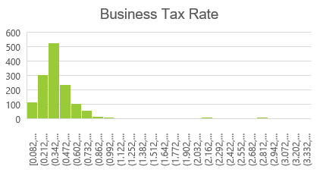
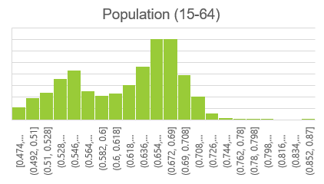
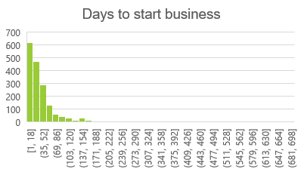
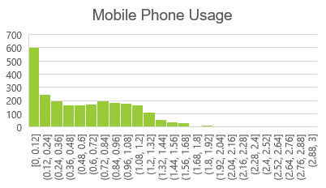
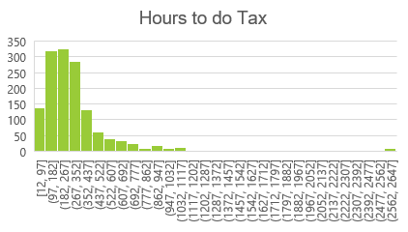

Slide 15
